Slide 1

'Category O' Analysis
Inez Gunawan, Saier (Sam) Hu, Yiru Lin, Brody Patterson, Kenny Wang

Slide 2
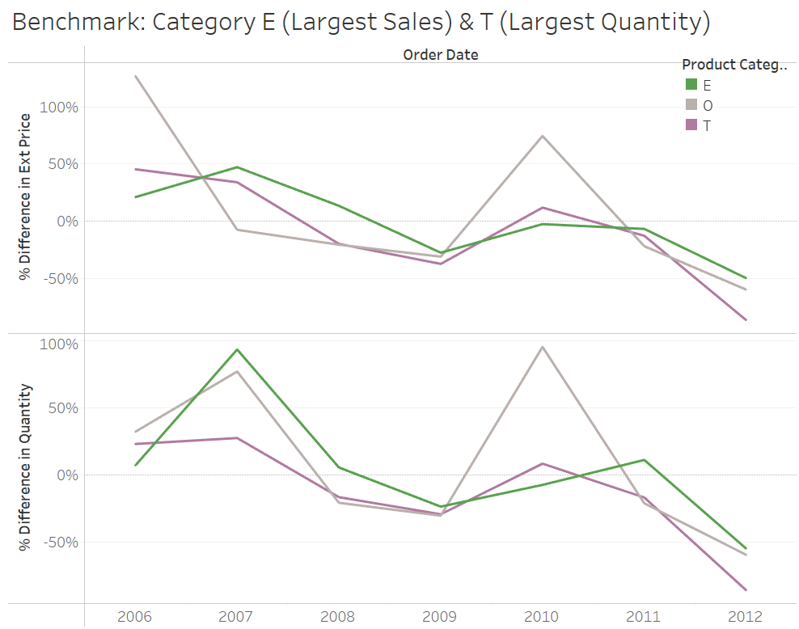
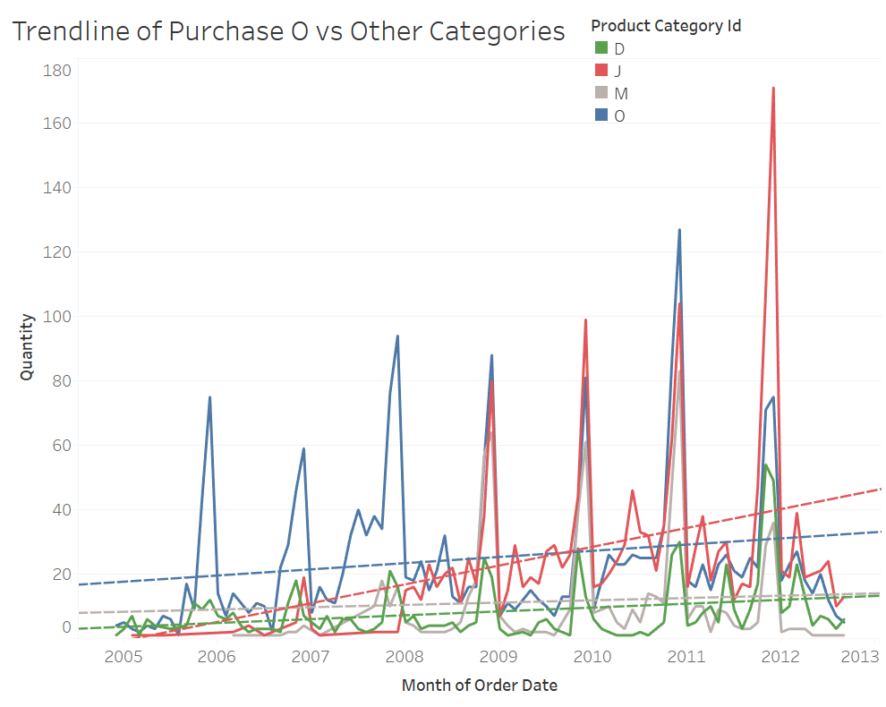
Category O's Growth In Comparison To Other Categories
Growth rate in sales price and quantity outperformed leading categories in 2010 and performed largely on par with benchmark categories in other years.
Notes:
Category O accounts for 3,359 units (1% )of the total sale quantity. But....
Comparison to Largest Sales (right) - might look crazy different, but that's because category O is just a smaller category in comparison to all
Comparison to other categories (left) - in actuality, it follows a similar trends with other categories

Slide 3
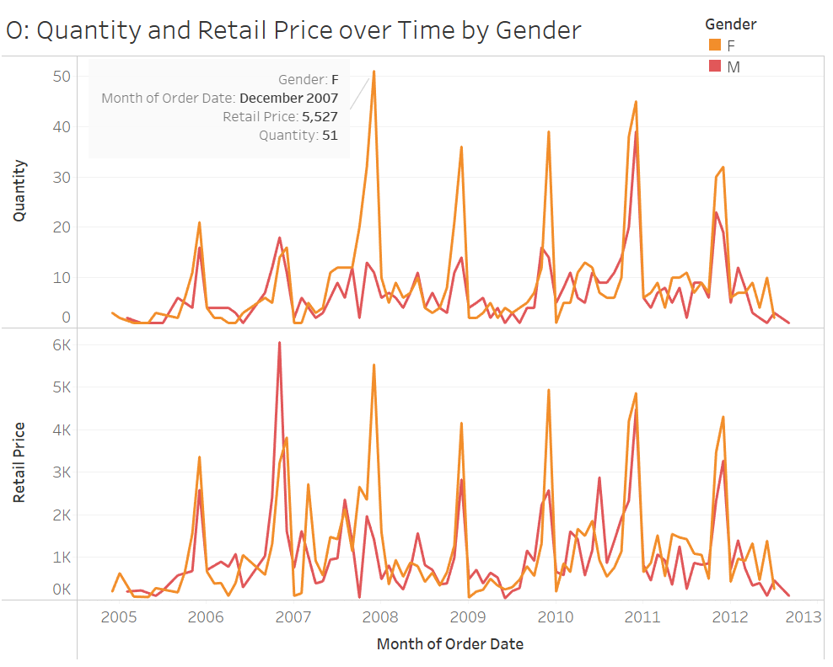
A Closer Look – Trends by Year and Gender
Takeaways
Category O tends to attract more female customers then male customers.
Category O seems to be a seasonal product; most of sales are generated between October and December.
The divergence in retail prices between genders is less pronounced.
Notes:
Category O accounts for 3,359 units (1% )of the total sale quantity.
There is a cyclical trend of spiked retail price and spiked purchased quantity every December on every year.
Women are charged more and also purchase more

Slide 4
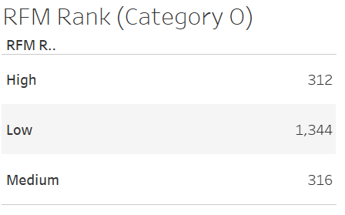
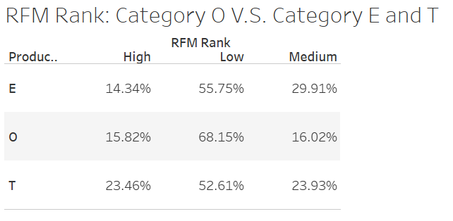
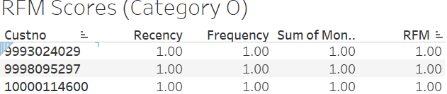
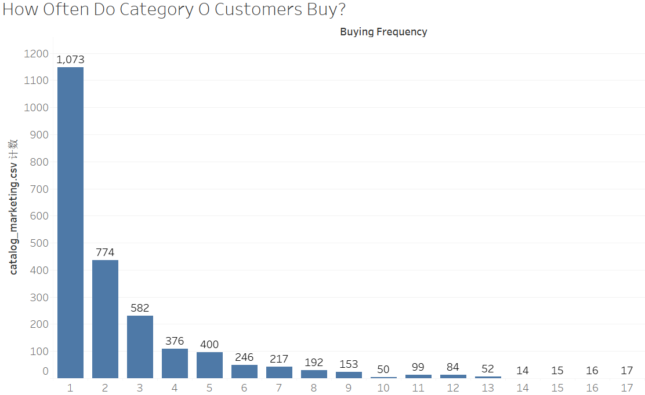
RFM and Customer Characteristics
*Example of most valuable customers (lowest RFM scores)
1,972 unique customers in category O:
1. Potential Outliers: One customer placed 42 orders, and two customers placed 26 orders
2. Target and retain high RFM ranking customers (those with low RFM scores) because they are the most profitable and they purchase often. How do we do this? -> Discount
3. Launch marketing campaigns to
Grow total number of customers! Build awareness.
Transform low RFM ranking customers to medium/high: Low RFM ranking customers currently constitute 68.15%, a much higher percentage than sales leaders such as Category E and T

Slide 5
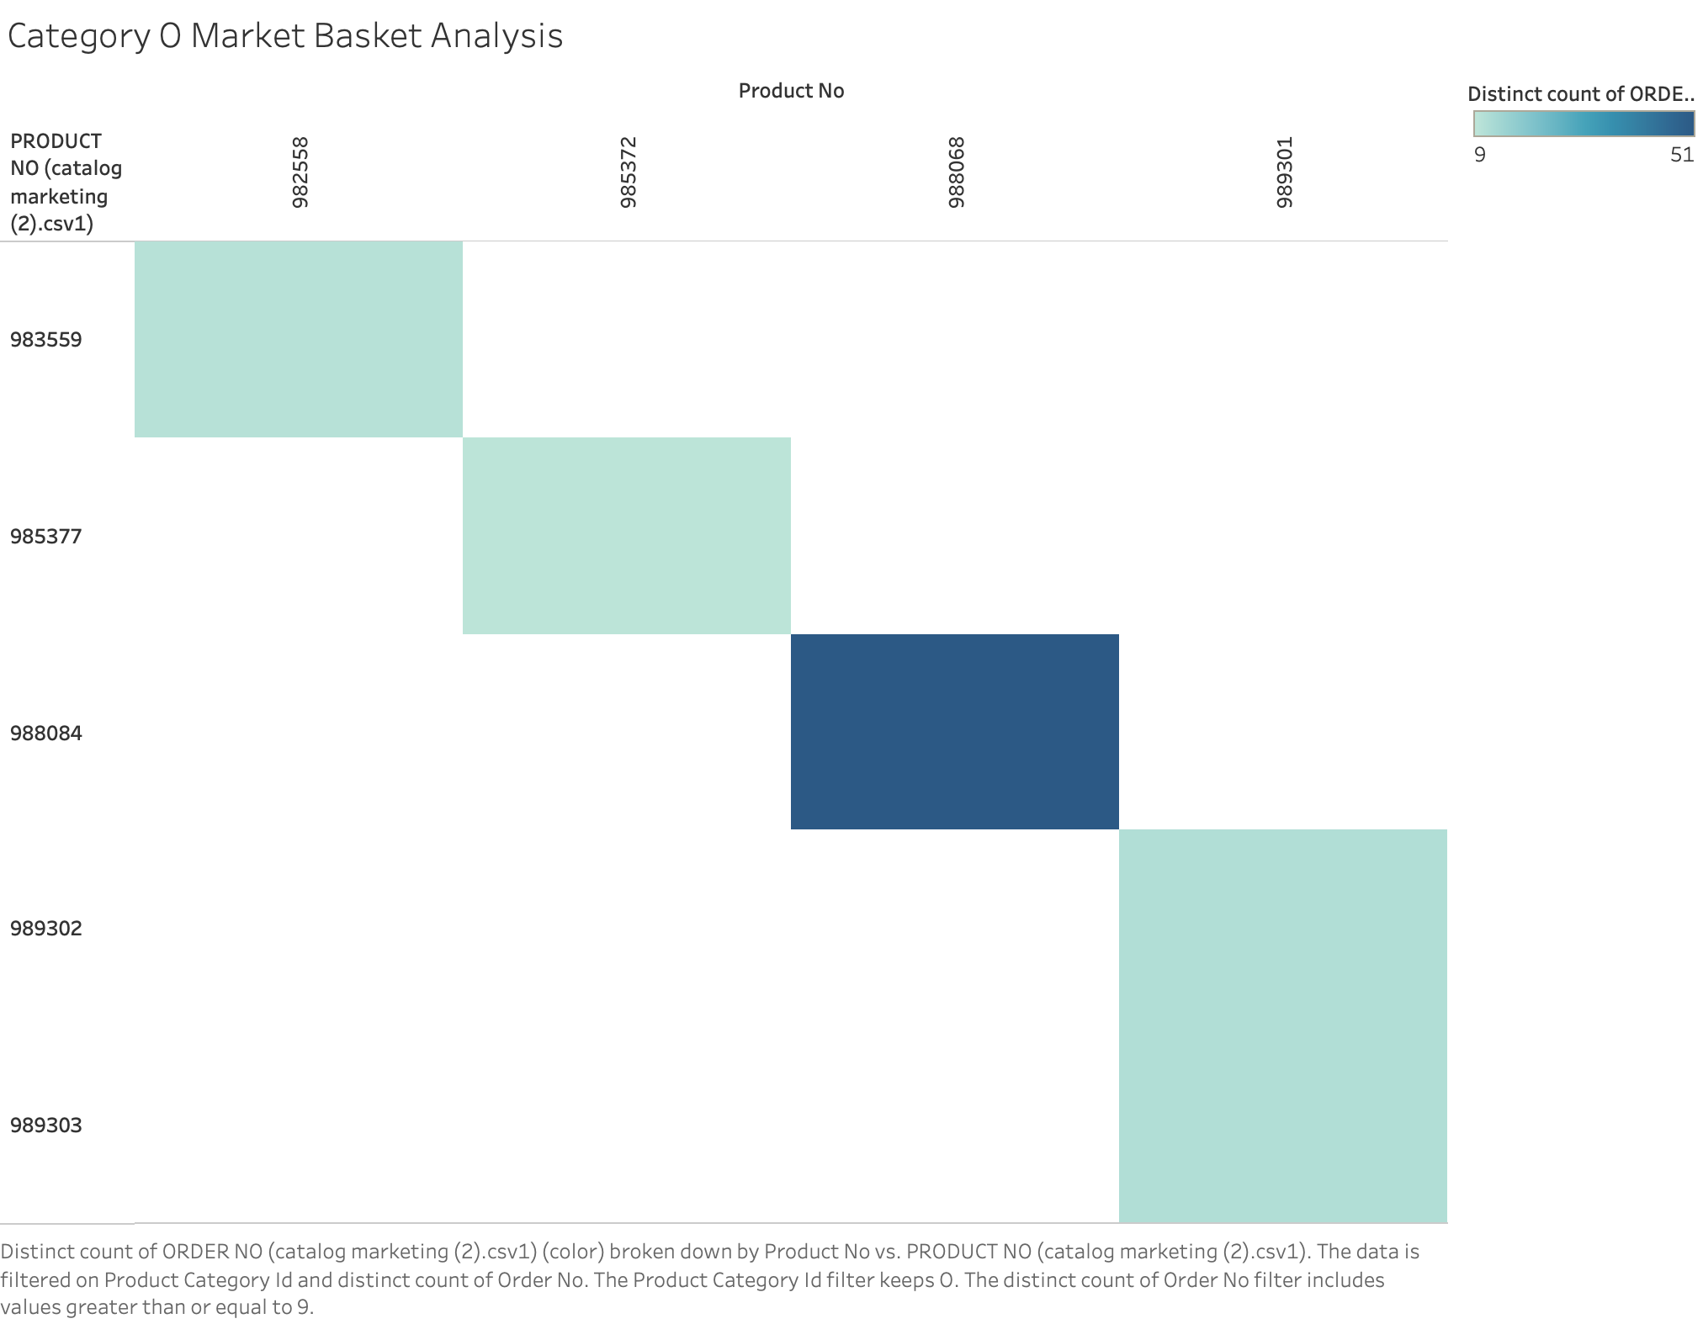
Market Basket Analysis
Takeaways from Market Basket Analysis
There are 59 unique products within Category O
Product 988084 & 988068 are the two products that are most frequently purchased together by customers (51 CNTD)
Product 989301 & 989302, and Product 989301 & 989303 (11 CNTD)
Product 983559 & 982558 (10 CNTD)
Product 985377 & 985372 (9 CNTD)
Company should consider bundling these products together or placing them near each other in the store to increase sales, as customers have proven to buy these product combinations together.
Note: Filtered from the market basket analysis
Note: CNTD refers to count distinct
Notes:
Yiru

